Slide 1
Open Addressing Methods for Hash Tables
By
Alexander Whitney Jun Hua Chen

Slide 2
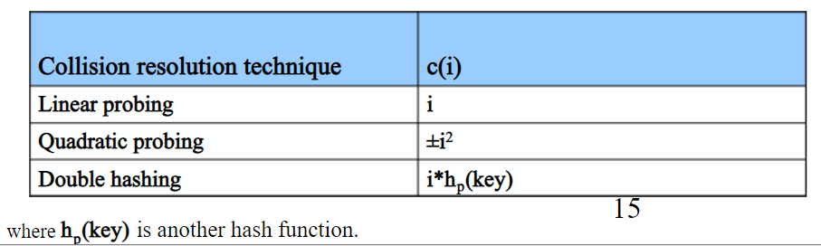
Algorithm Purpose
Open addressing methods are algorithms designed to handle collisions in hash tables. These collisions occur when a key is hashed to an index that is already occupied. There are various ways of handling these collisions, the three we chose to test are linear probing, quadratic probing and double hashing.

Slide 3
Problem Statement
Hash Tables are commonly used data structures, finding the optimal open addressing method will increase performance for Insert(), Search(), and Delete()
We are trying to observe how varying inputs, table size, and, load factors affect the number of collisions for linear probing, quadratic probing, and double hashing
The differences in number of collisions from different cases will show when one outperforms another

Slide 4
Implementation
What language did you use for your implementation? What data structure(s) did you implement
C++ class
Vectors to store hash table
Values Initialized to -1 (empty slot)
Limit each Quadratic probing to n times … where n is the TABLE_SIZE
Randomly generated numbers in the range of (TABLE_SIZE * 10)
To have a fixed proportion range for each different table size
Notes:
C++. Our hash table was simply a vector of integers because in our case we were only concerned with storing the key. In most cases the hash table would store a pair of integers, or some sort of object, that contains more data than just the key.

Slide 5
Algorithm
Linear Probing - index = key % size If index is occupied, increment index until open slot
Quadratic Probing - index = (key + i^2) % size (for i = 0 … size-1) If index is occupied, increment i until open slot (or until i = size) There is no guarantee of finding an empty cell once the table gets more than half full
Double Hashing - Utilized two hash function h1 and h2. Index = (h1 + i*h2) % size Works well when size is a prime number h1 is generally key % size h2 must not be evaluated to zero i*h2 must be able to cover all cells… for i =0 … size-1 Popular h2 function : prime - (key % prime) //where prime < size

Slide 6
Linear and Quadratic Probing Pseudo Code
LinearProbing(key){
index = key % size
while(hash[index] != -1){
index++
index %= size
collision++
}
return index
}
QuadraticProbing(key){
index = key % size
i = 0
while(hash[index]) != -1 && i < size){
index = (index + (i*i)) % size
collision++
i++
}
return index
}
*once i > size, quadratic will iterate over same indices

Slide 7
Double Hashing Probing Pseudo Code
DoubleHash(key){ hash1 = key%size hash2 = prime - (key % prime) //where prime is < size index = hash1 while(hash[index] != -1){ collision++ index = (index+hash2) % size
} return index
}

Slide 8
Algorithm Analysis
What are the interesting features of the algorithm? What is its time complexity, and why?
O(n) where n = number of insertions
Dependent on input
Dependent on collisions
Randomly varies on combination of input, hash method, and table size
Notes:
All of the open addressing methods we examine are O(n) time complexity, where n is the number of insertions. This is because each algorithm has a constant runtime, and can be executed at most n times. In order to achieve this runtime for quadratic probing and double hashing, the auxiliary constants selected must try to limit repetitive collisions.
The interesting part of this algorithm is their performance is almost entirely dependent on the input. The runtime is dependent on number of collisions, which randomly varies based on the combination of the specific input, hash method, and table size.

Slide 9
Experimental Plan
9 tests for each open addressing method on # of collisions
At 3 different table sizes and 3 different load factors for each (3 x 3)
Table size - {11, 29 , 101}
Load factor - {40% , 60 %, 80%}
Compute average of 50 trials of all 9 tests
Export dataset to Excel
Compare average based on load factors, table size, and probing methods
Compare collision per insertions
Notes:
We chose to run 3 tests for each open addressing method, each with a constant hash table size and input size, and a varying load factor (input size/table size). We chose input and table sizes that gave us load factors of 40%, 60% and 80%. This is because the load factor greatly influences how many collisions a hash table will encounter. We ran these tests 20 times to get an average. (We then repeated this process with varying input sizes to see how that would affect the number of collisions)
The input was randomly generated so each method could be compared on the same input, and then inputs were randomly regenerated for each iteration of tests. We chose to only vary the input and not the input size or table size, because we want to see how these methods differ without skewing our results with bad load factors.
Compare collisions/insertion

Slide 10
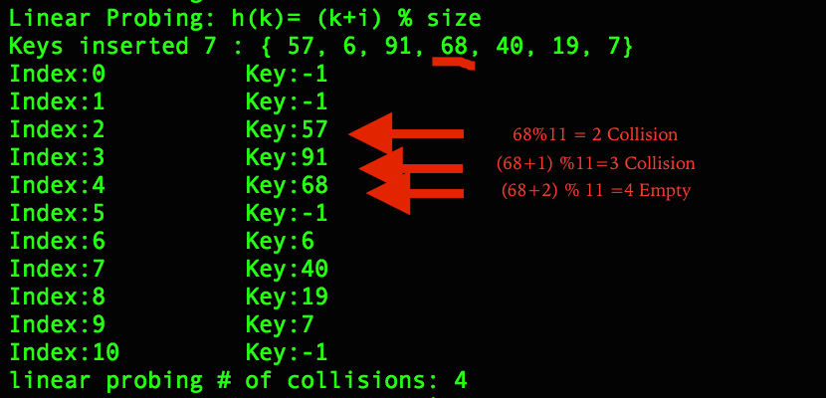
Demo(1)

Slide 11
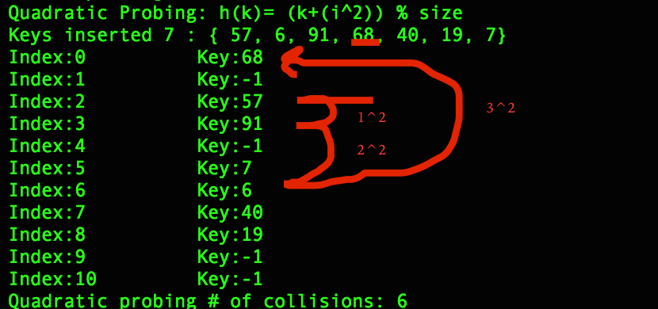
Demo(2)

Slide 12
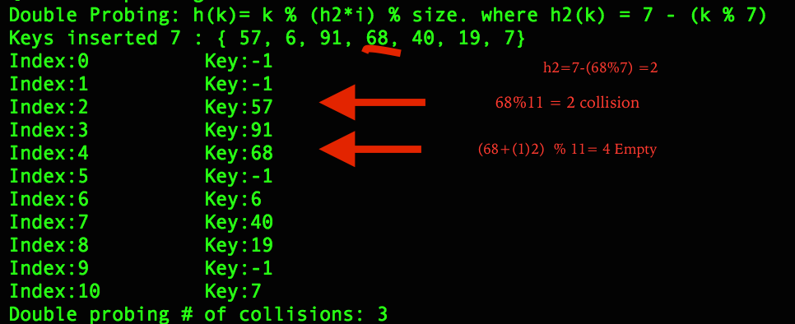
Demo(3)

Slide 13
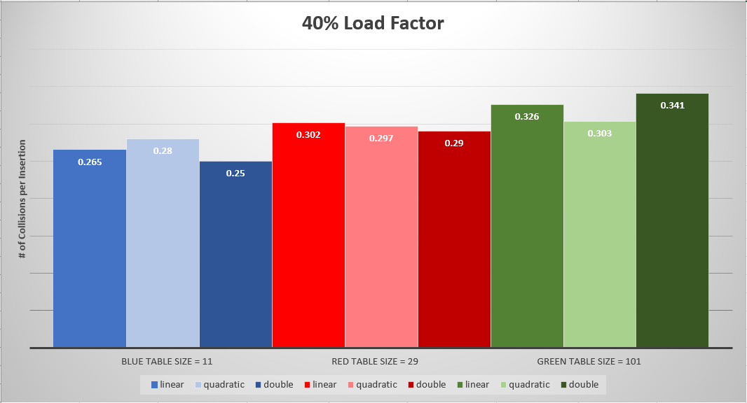
Results(1)
Notes:
Linear and quadratic ~2.5% better than double at n = 101 in terms of percentage of number of insertions per collision

Slide 14
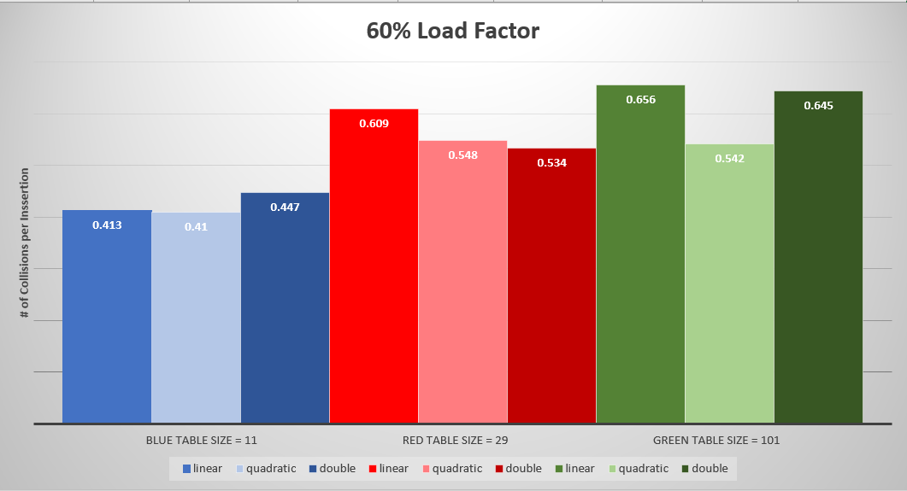
Results(2)

Slide 15
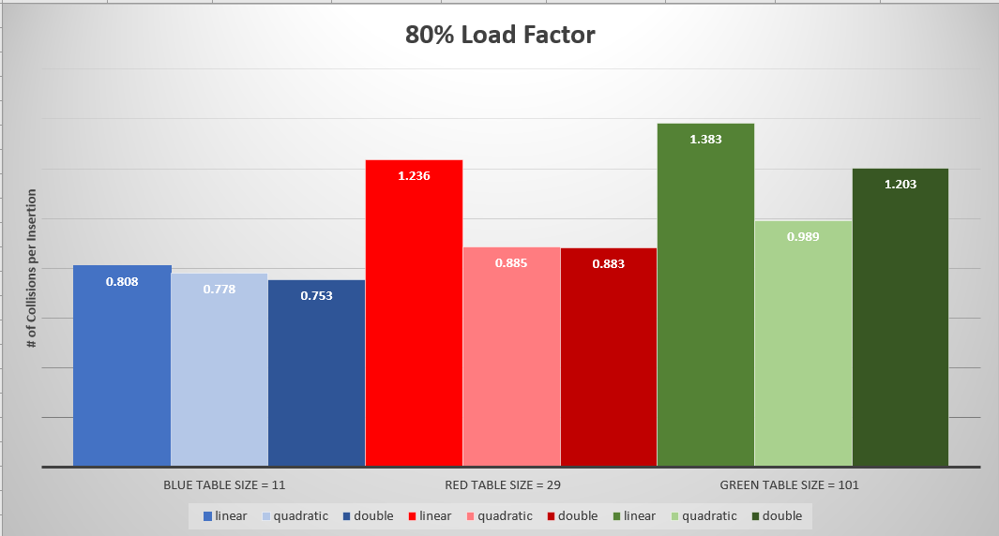
Results(3)

Slide 16
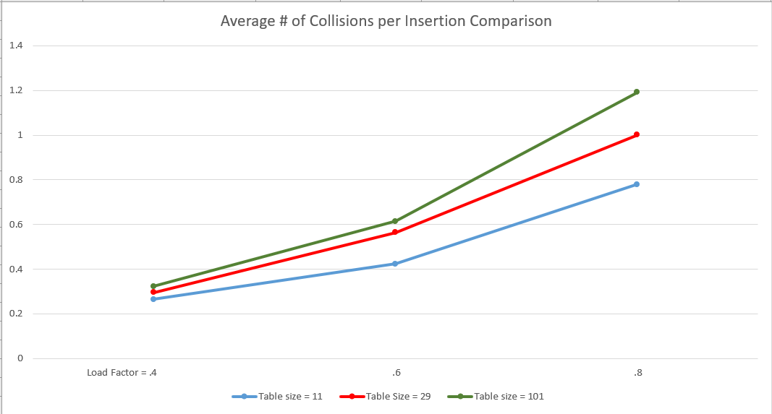
Results (4)

Slide 17
Results(5)
As table size increases, the number of collisions per insertion increases
As load factor increases, the number of collisions per insertion increases
As load factor increases, the difference in performance between the three open addressing methods increases
Linear probe generally performs the worst - sees a more dramatic increase in number of collisions per insertion as table size or load factor increase
Quadratic probe and double hashing perform similar in most scenarios - better performer will be dependent on how the given keys translate with the underlying hashing methods

Slide 18
Limitations and Future Work
Our quadratic probe and double hash methods were only tested using general formulas, while most likely more optimized formulas exist
Additional tests could be ran with various auxiliary constants to optimize the number of collisions for these two methods
Additional tests with larger table sizes could offer a better representation of the expected number of collisions for real life programs
Determine optimal load factor to Rehash() table size

Slide 19
Concluding remarks
To minimize the number of collisions per insertion, it is best to keep the load factor (input size/table size) low
The lower the load factor, the less collisions per insertion and the choice of open addressing method will matter less
So it is okay to pick an easy implementation (Linear)
The larger the load factor, the greater variance in number of collisions per insertion, and quadratic probing or double hashing will outperform linear
When load factor gets too high, the hash table should be resized (made bigger) to decrease the number of collisions
Notes:
Mention insignificant difference in collision per insertion

Slide 20
Thank You!
Questions?

